Slide 1
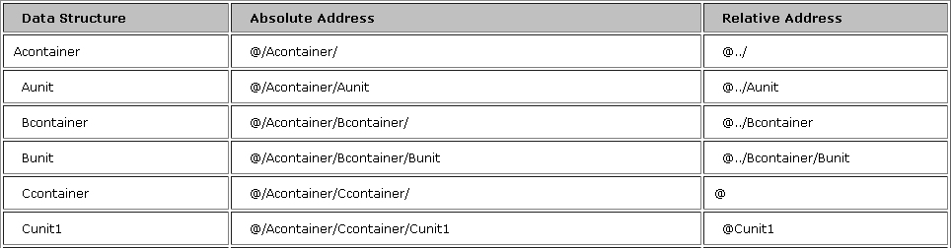
Absolute and Relative Address
A
Acontainer
a
Aunit
B
Bcontainer
b
Bunit
C
Ccontainer
c
Cunit
@@-- refer to the source data unit
@ThisOccurrence--Actual position of the actual source container occurrence.
@LastOccurrence--Last position of the actual set of source container occurrences, that is, the total number of occurrences.
Addressing an occurrence
@/AAA[3]/BBB[2]/ccc
@../BBB[@ThisOccurrence]/ccc
Shared Services Center | Global Integration & eServies

Slide 2
DMU Functions
Local variable, scratch pad, literal
  Feature of datamapper utility:
    Start with “DMU”
  Example:
    DMU.DateNow()
      (format) – returns formatted current date and time
      Formats: 1996-12-15 is “%Y-%m-%d”
    DMU. DMU.DateConvert()
      (date, informat, outformat) – Returns a translation of a date
      Example:
      $output=DMU.DateConvert( $input, "%Y%m%d%H%M%S%, "%Y-%m-%dT%H:%M:%S" );
      $input is “20211011052822”, $output is “2021-10-11T05:28:22”
    DMU.Left()
      DMU.Left - Returns the left-most part of a string.
      DMU.Left( string, count )
  Utility library:
    Details please check the Help document
Shared Services Center | Global Integration & eServies

Slide 3
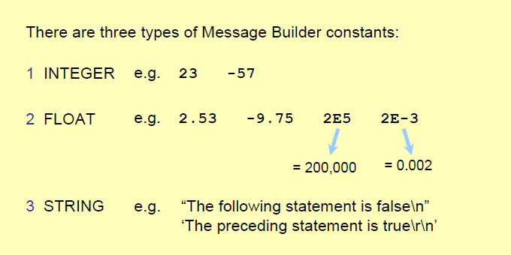
MB Language and Link Code
Shared Services Center | Global Integration & eServies

Slide 4
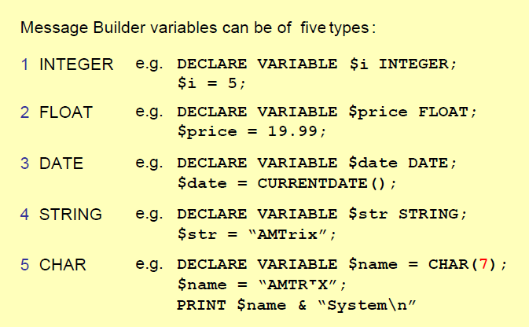
MB Language and Link Code
Shared Services Center | Global Integration & eServies

Slide 5
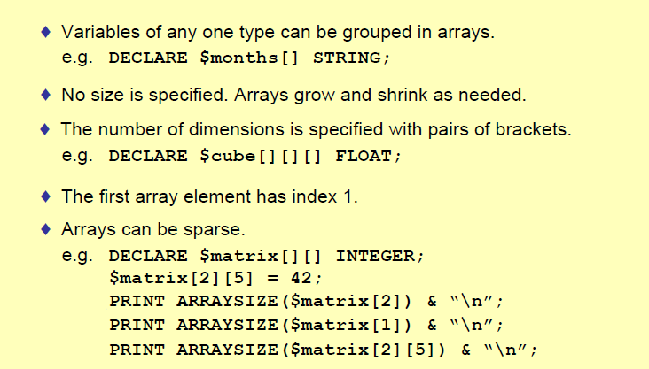
MB Language and Link Code
Shared Services Center | Global Integration & eServies

Slide 6
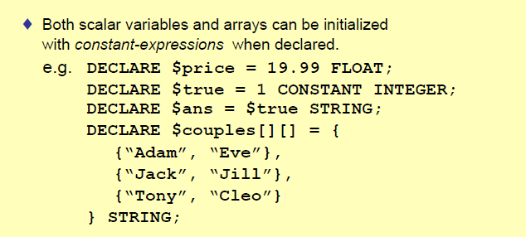
MB Language and Link Code
Shared Services Center | Global Integration & eServies

Slide 7
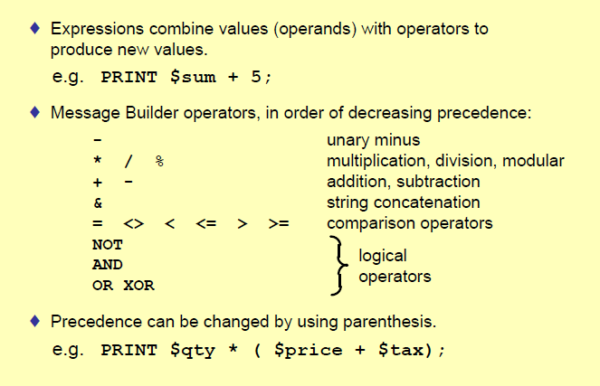
MB Language and Link Code
Shared Services Center | Global Integration & eServies

Slide 8
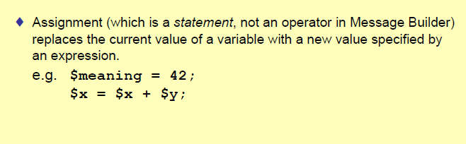
MB Language and Link Code
Shared Services Center | Global Integration & eServies

Slide 9
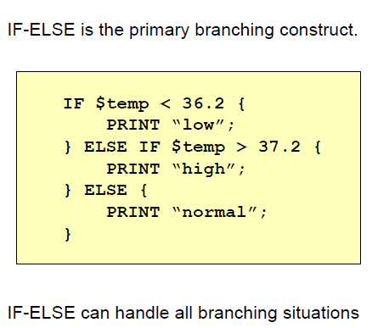
MB Language and Link Code
Shared Services Center | Global Integration & eServies

Slide 10
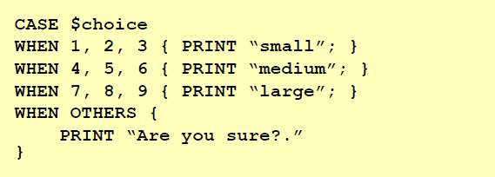
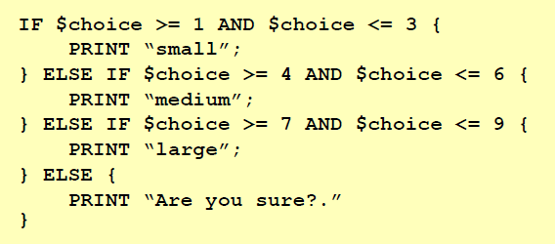
MB Language and Link Code
Shared Services Center | Global Integration & eServies

Slide 11
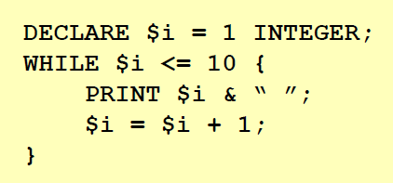
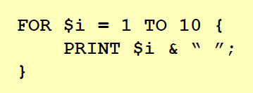
MB Language and Link Code
Shared Services Center | Global Integration & eServies

Slide 12
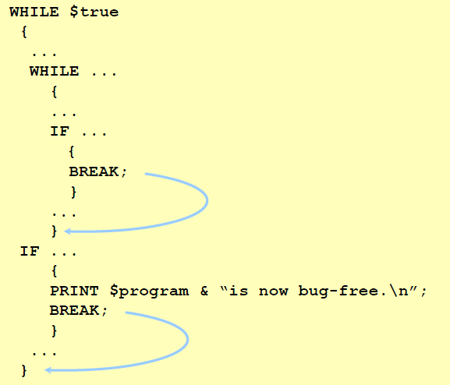
MB Language and Link Code
Shared Services Center | Global Integration & eServies

Slide 13
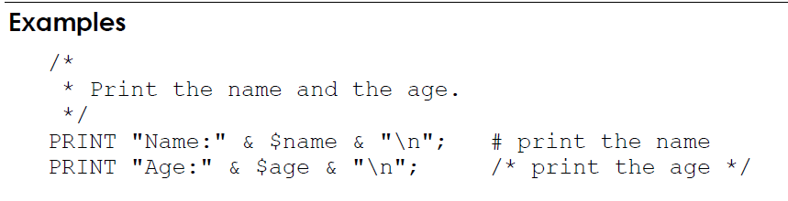
MB Language and Link Code
Comments, TraceLog
TraceLog "$sv_LOC_Qualf: " & $sv_LOC_Qualf, SOURCELINE(), "Debug","KEEP_YES";
Shared Services Center | Global Integration & eServies

Slide 14


MB Language and Link Code
Functions
  Functions in MB language:
  Example:
    STRFORWARD(string, search[, start])
      If the search string is found, return the position. Otherwise, return 0
    STRLEN(operand)
      Function that returns the length of a string
    FORMAT(format [, argument, ...])
      FORMAT("%.2f", $f)
  Function library:
    Details please see the attached materials
Shared Services Center | Global Integration & eServies

Slide 15

MB Language and Link Code
Functions
  SAG functions for Sword system
  Function library:
  Database table
  Routing code
  Reference value
  Counter file
  Note: Details please see the attachment
Shared Services Center | Global Integration & eServies

Slide 16
MB Language and Link Code
SAG function example:
Database table
  Get the information:
sag_db.Init;
DECLARE $la_City[][] STRING;
DECLARE $lv_Shipping_point STRING;
DECLARE $lv_City STRING;
$la_City = sag_db.GetGenericValues("SELECT CITY FROM DYN_ERICE2AEDA_SHP_POINT
WHERE SHIPPING_POINT = '" & $lv_Shipping_point & "'");
$lv_City = $la_City[1][1] ;
Initialize
Declaration
Field name of the reference value
Field name of return value
Table name
Shared Services Center | Global Integration & eServies

Slide 17
Directives
1. //NORMAL – used in 1:1 map when in and out adf are the same
2. Encoding
//CSC_NAME=utf8
3. EDI separators
Type of Separator | Override Directive
Segment separator | EDISEGSEP=char
Composite separator | EDICOMPSEP=char
Element separator | EDIELEMSEP=char
Release character | EDIRELEASE=char
Schenker China Ltd.

Slide 18
Directives
4. //TRIM
Remove trailing field delimiters
Used when the field delimiter just before the record separator is omitted
5. //TRUNCATE
Remove empty fields at the end of a record
Used when all empty fields at the end of a record are omitted
6. //INPUT //OUTPUT
Schenker China Ltd.

